Slide 1
Azure DR / Business Continuity
& Windows 10 Overview
Rich McBrine, CISSP, ITILv3
Cloud Solutions Architect
rmcbrine@Microsoft.com
Notes:
2/25/2015
© 2012 Microsoft Corporation. All rights reserved. Microsoft, Windows, and other product names are or may be registered trademarks and/or trademarks in the U.S. and/or other countries.
The information herein is for informational purposes only and represents the current view of Microsoft Corporation as of the date of this presentation. Because Microsoft must respond to changing market conditions, it should not be interpreted to be a commitment on the part of Microsoft, and Microsoft cannot guarantee the accuracy of any information provided after the date of this presentation. MICROSOFT MAKES NO WARRANTIES, EXPRESS, IMPLIED OR STATUTORY, AS TO THE INFORMATION IN THIS PRESENTATION.
1
Windows Server Management Marketing

Slide 2
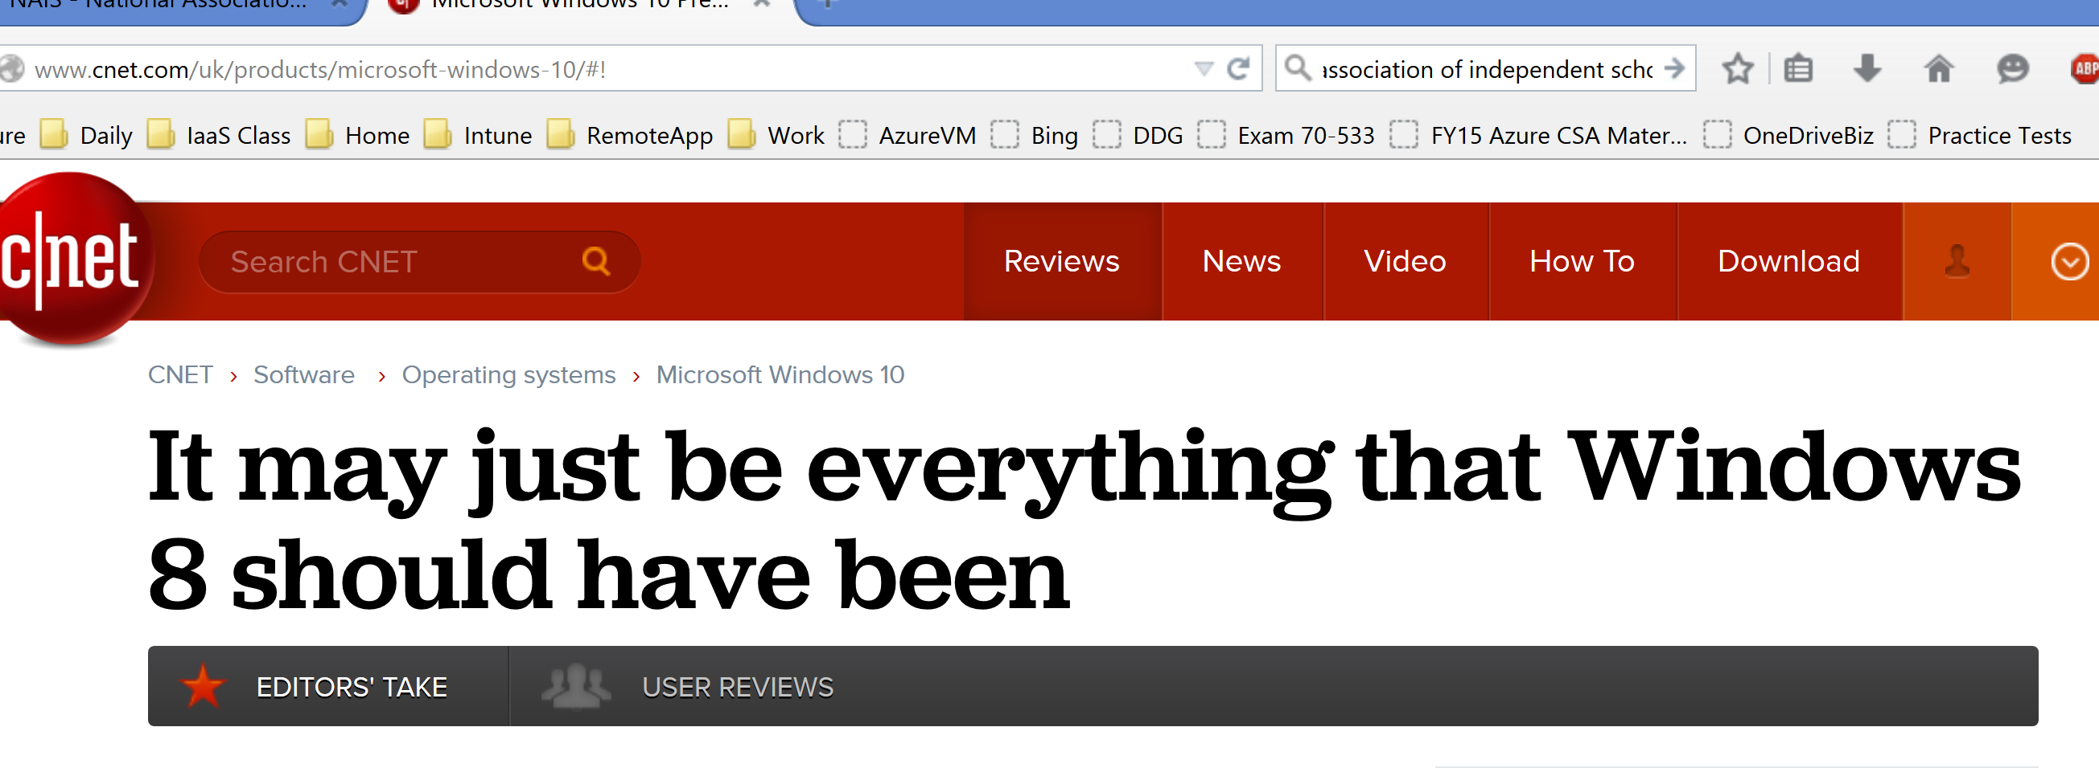
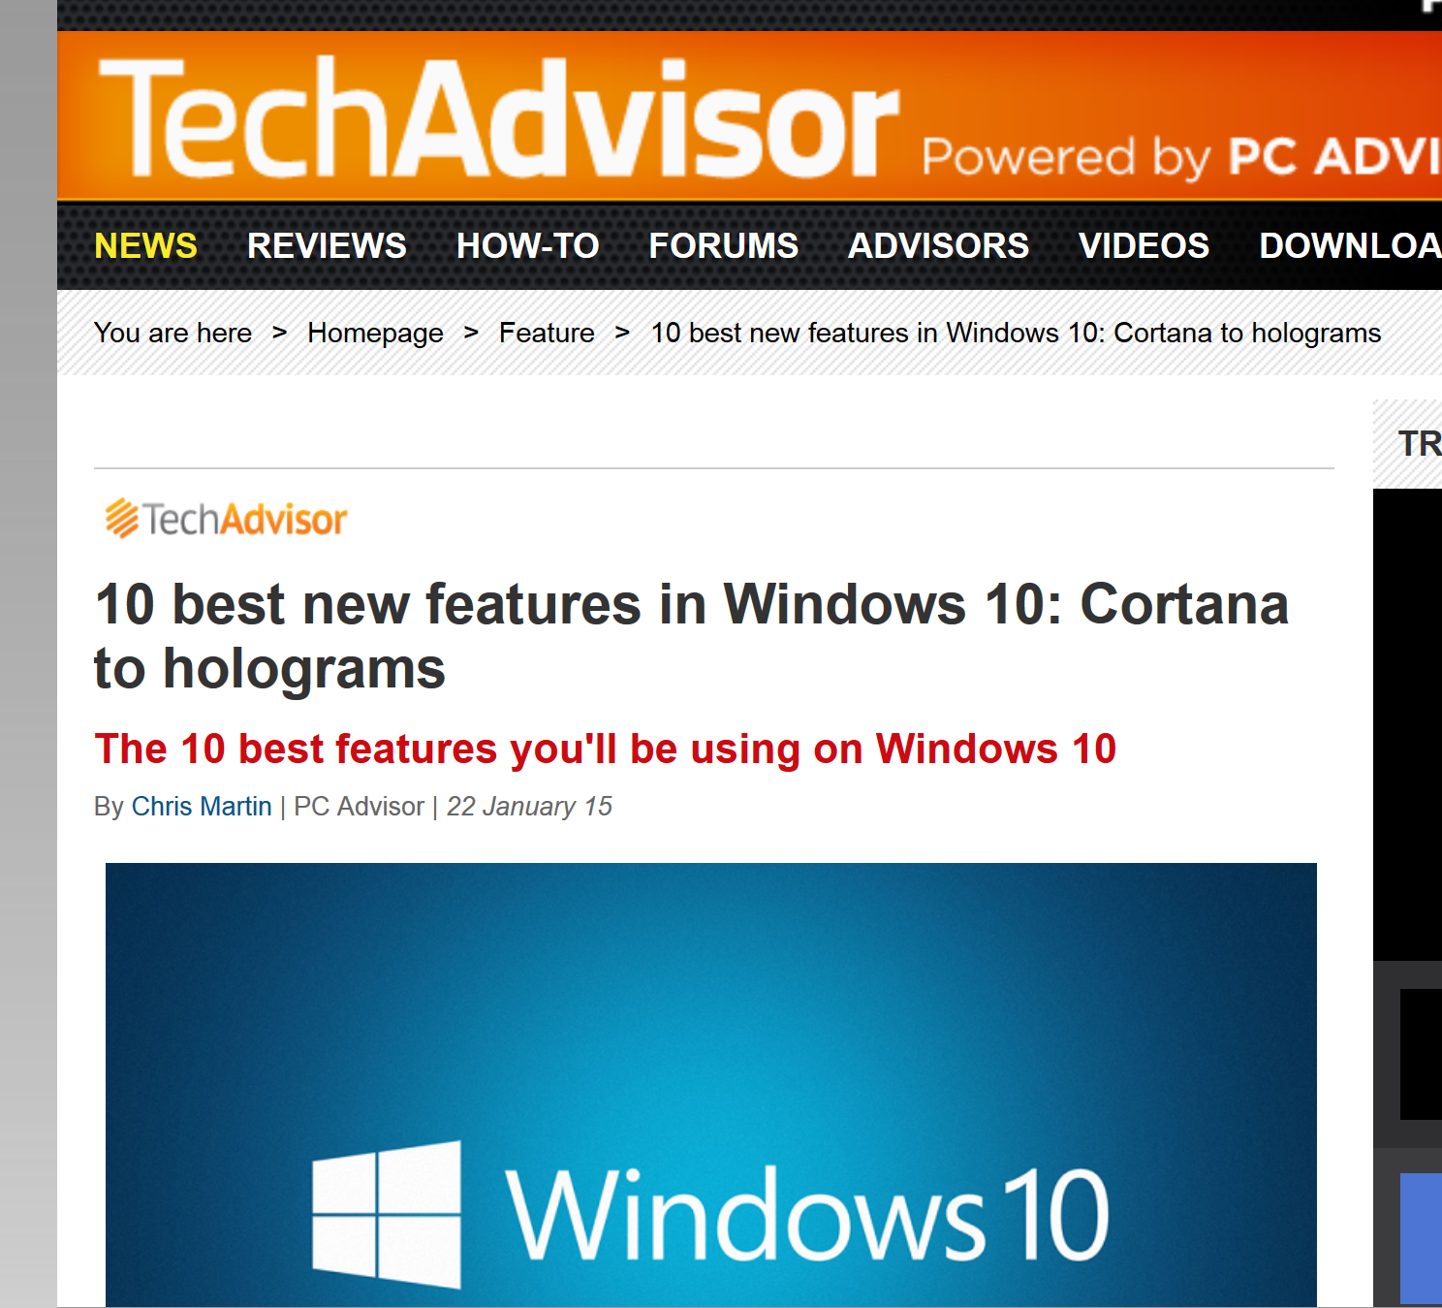
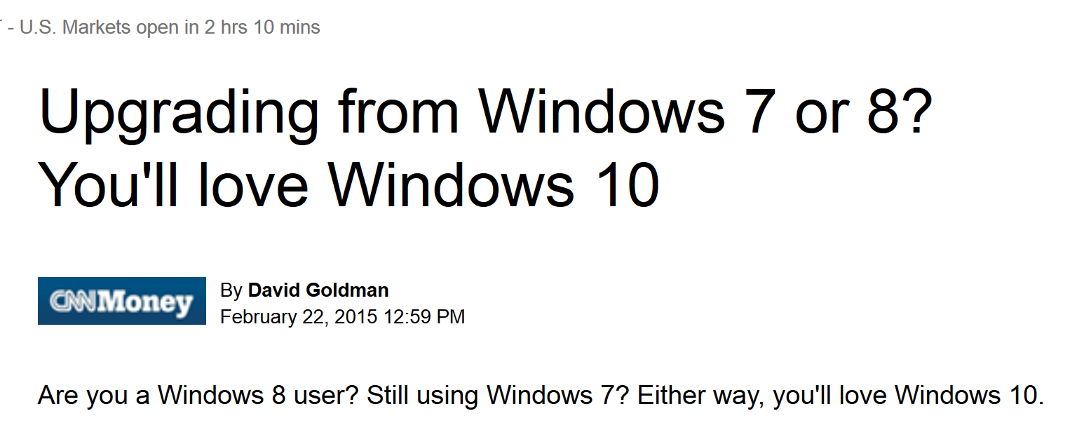
The Windows 10 Buzz

Slide 3
Windows 10 – Key Innovations

Slide 4
Key Windows 10 Changes (esthetics)
UI changes minimal – option of Start Menu / Tile Menu
Resizable Live Tiles in-menu
Modern apps introduced in Windows 8 open as classic windowed app
New Snap operations
Virtual Desktop experience – Task View button
Centralized / Simplified Control Panel experience
Centralized Notification experience
Cortana for search / lifestyle updates
“Find PowerPoint slides about the charity auction”
“Show me photos from December”
Spartan Web Browser
Reading Mode - strips ads and sidebars out of webpages - appears similar to a book
Annotation & note-sharing capabilities

Slide 5
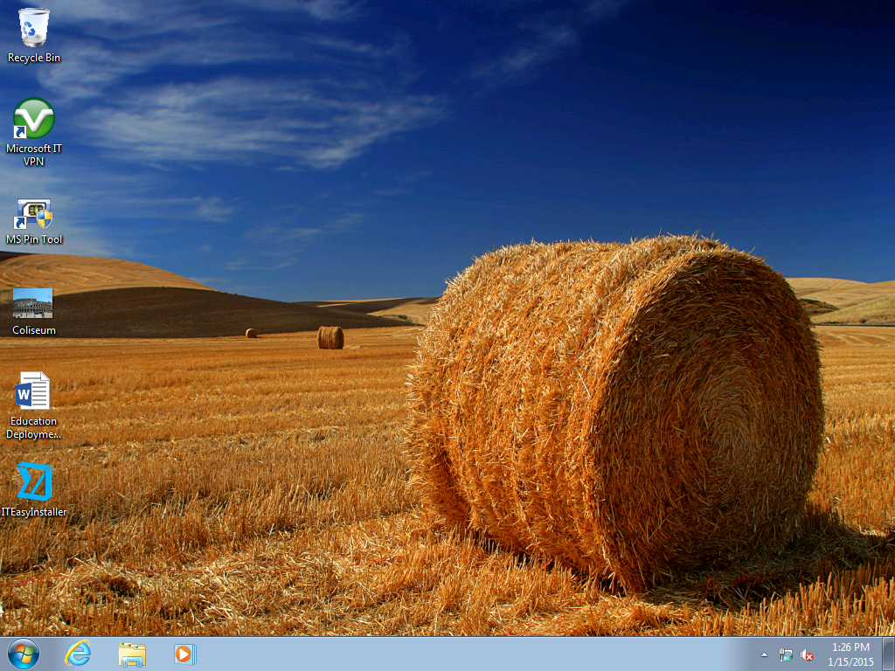

Slide 6
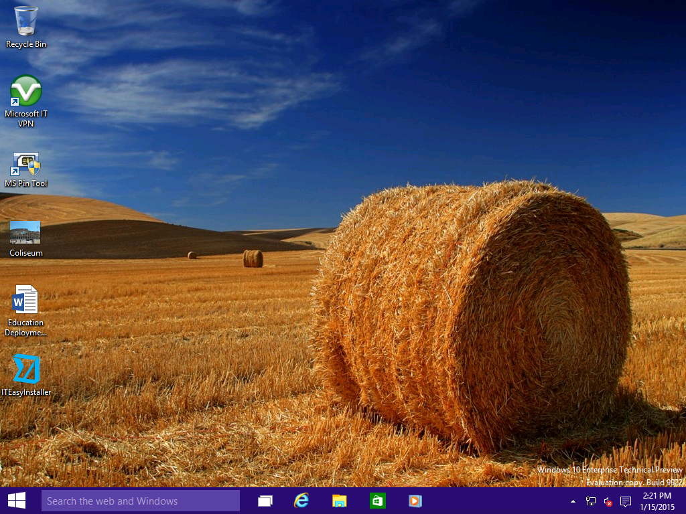

Slide 7
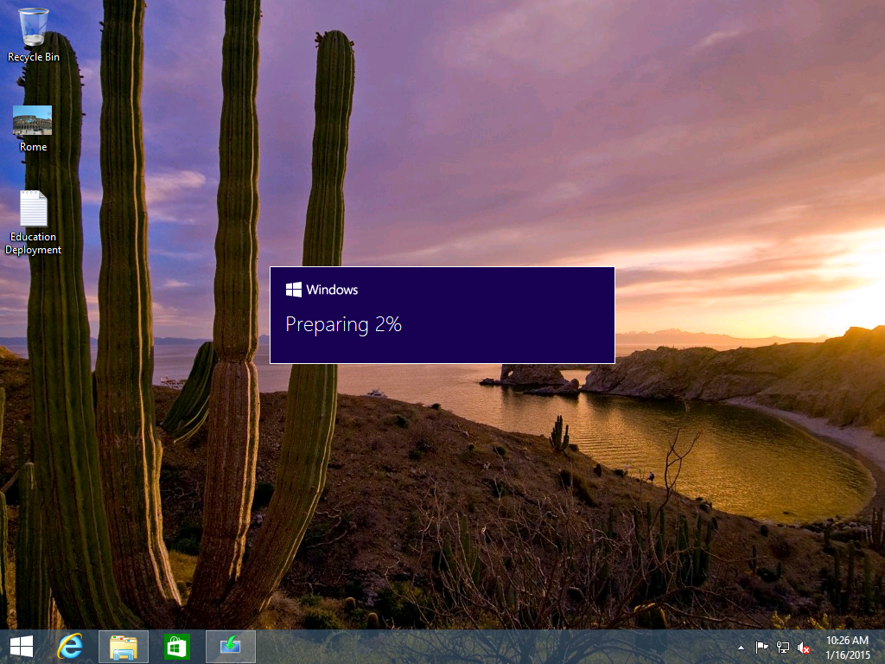

Slide 8
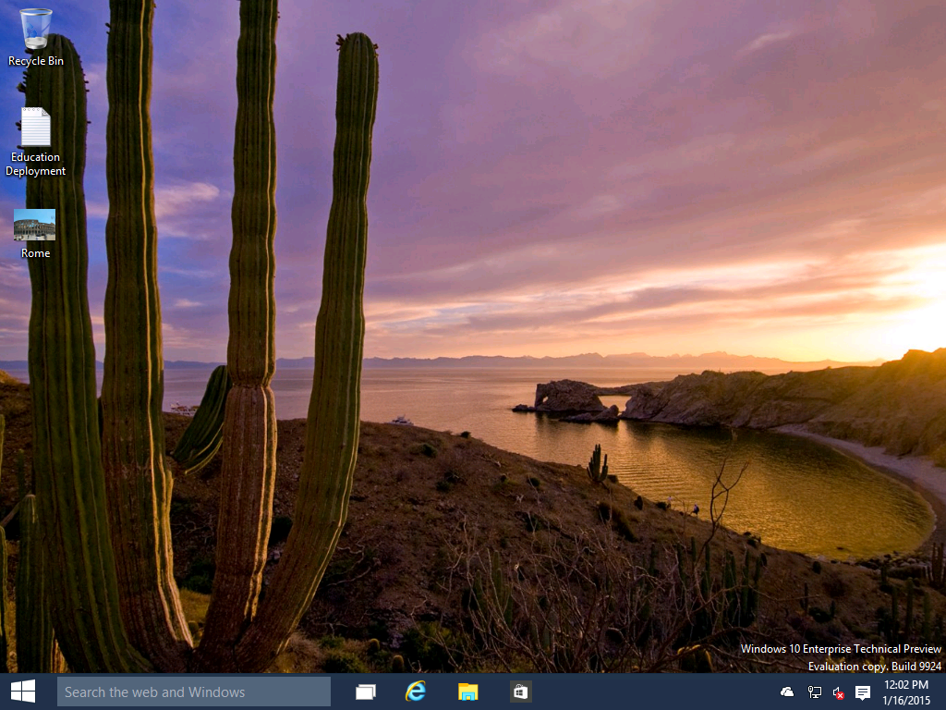

Slide 9
Key Windows 10 Changes (esthetics)
UI changes minimal – option of Start Menu / Tile Menu
Resizable Live Tiles in-menu
Modern apps introduced in Windows 8 open as classic windowed app
New Snap operations
Virtual Desktop experience – Task View button
Centralized / Simplified Control Panel experience
Centralized Notification experience
Cortana for search / lifestyle updates
“Find PowerPoint slides about the charity auction”
“Show me photos from December”
Spartan Web Browser
Reading Mode - strips ads and sidebars out of webpages - appears similar to a book
Annotation & note-sharing capabilities

Slide 10
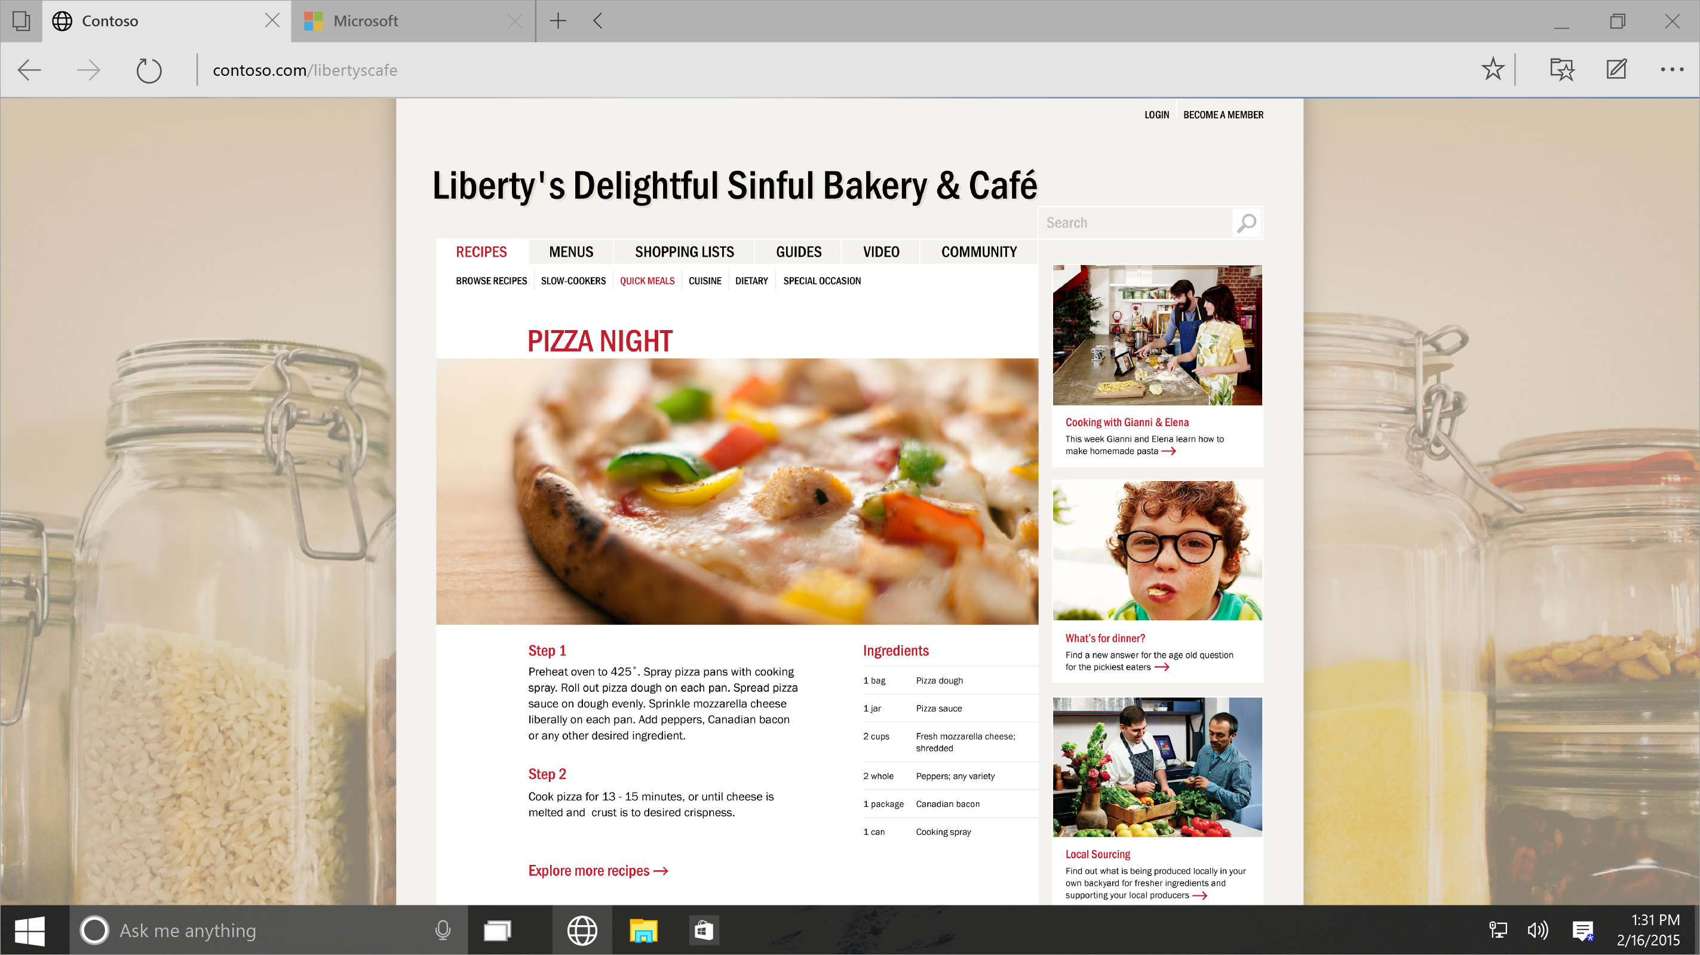
Notes:
Let’s look at some of the “meta-features” of Project Spartan that make it cleaner, smarter, and better at all the things you do online. Imagine the thrill of writing directly on webpages and sharing your mark-ups with others, and the convenience of reading ad-free articles and saving your favorite reads for offline access.
Let’s say you find a pizza recipe you love.

Slide 11
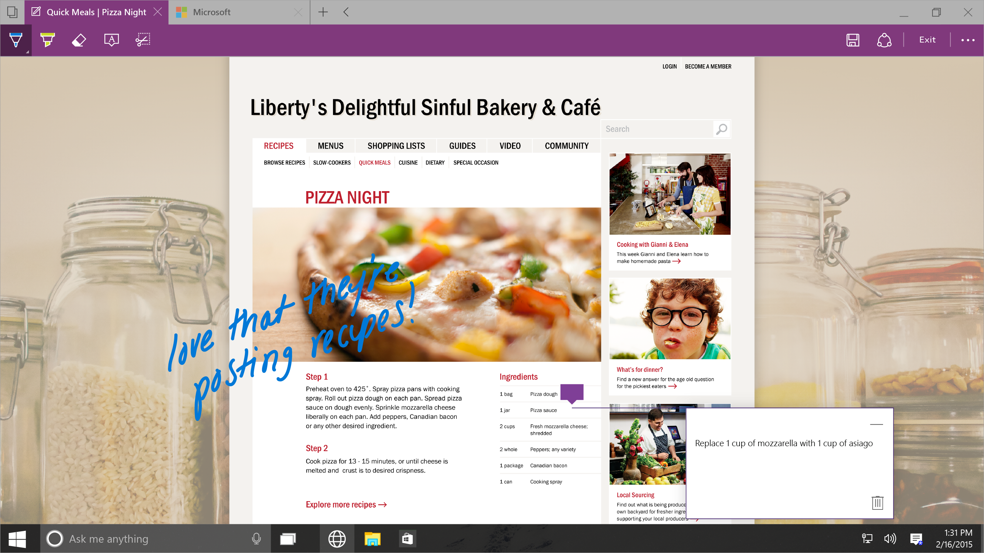
Notes:
You can add annotations right on the page, with pen or mouse and keyboard.

Slide 12
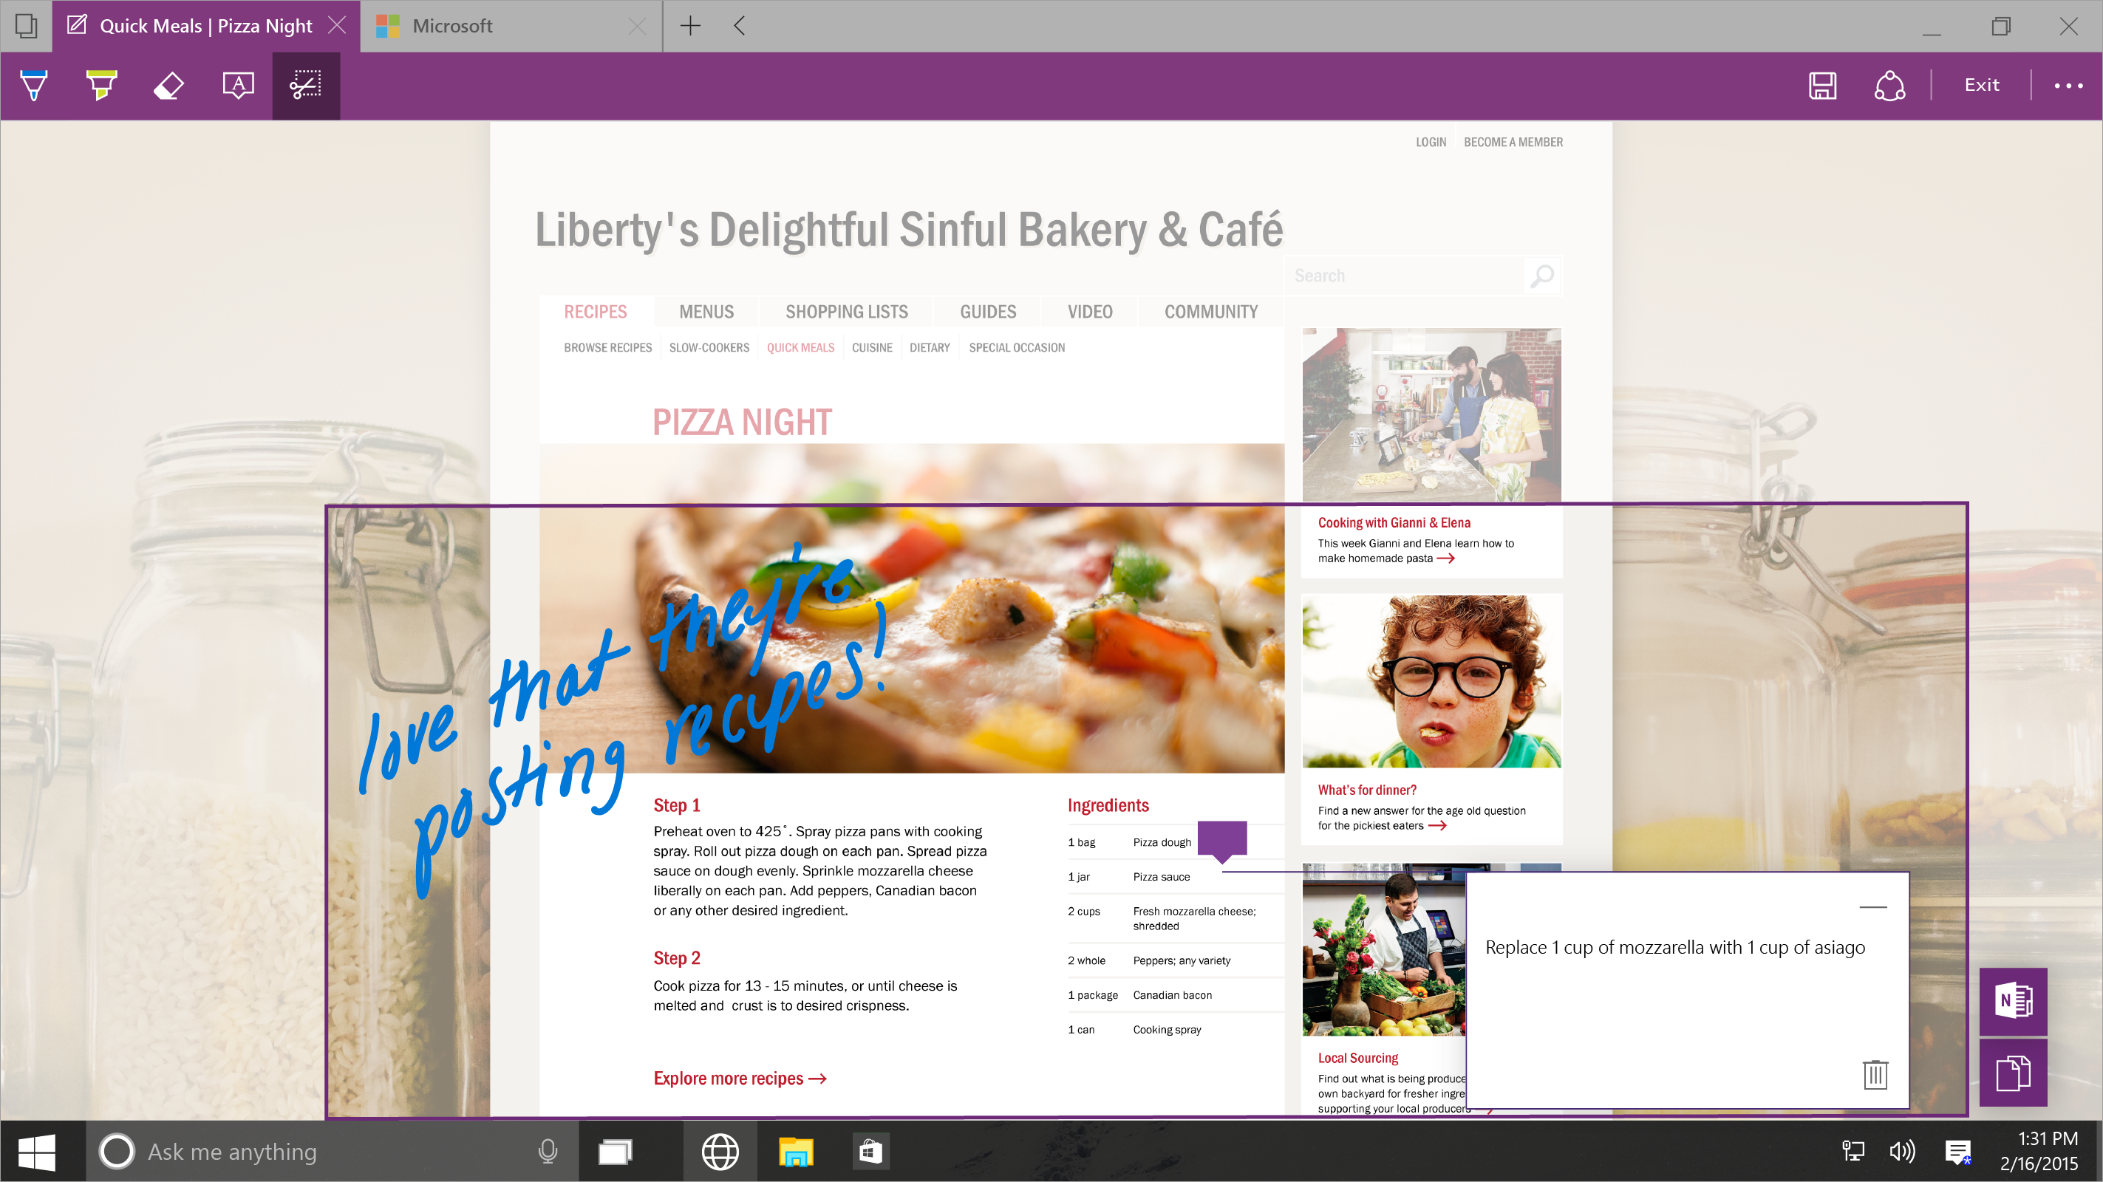
Notes:
You can easily clip the information to OneNote.

Slide 13
Key Windows 10 Changes (behind the scenes)
Security enhancements to combat real-time threats
Windows Store improvements to support EDU
Mobile Device Management built-in
Universal Apps – one code base
Photos, Videos, Music, Maps, People & Messaging and Mail & Calendar (and more) look and feel the same across different devices and screen sizes
Universal App information syncs automatically via OneDrive
Wipe and Load no longer required
Better configuration tools / manageability without full imaging

Slide 14
New Challenges Require a New Platform
Windows 7
Windows 10
Offers an easy to use and deploy multi-factor solution with anti-theft and anti-phishing. Comes with the convenience of a password, but the security of the best multi-factor solutions.
Identity protection
Passwords theft is increasingly successful and today’s multi-factor solutions have proven cumbersome and costly to deploy.
Data protection
Offers optionally configurable disk encryption, but lacks integrated DLP.
Use of 3rd party solutions with varying experiences on mobile and desktop.
Disk encryption increasingly enabled OOB and is highly manageable.
Data loss prevention and data separation is fully integrated into the experience.
Threat resistance
Apps are trusted until they’re determined to be a threat.
No realistic way to detect 300K’s+ new threats/day. Frequent use of 3rd party.
Mobile level of lockdown possible for desktop machines.
Devices able to move trusted app model where untrusted apps are unable to run.
Platform security built on software alone creates opportunity for malware to hide from security solutions, embedding in the device itself.
Integrated platform and hardware security provides protection from power on to power off and eliminates opportunities to tamper with and hide from the system.
Device security

Slide 15
Windows Store: Ready for education
Volume licensing
Flexible distribution
License reclaim/re-use
Curated education app store

Slide 16
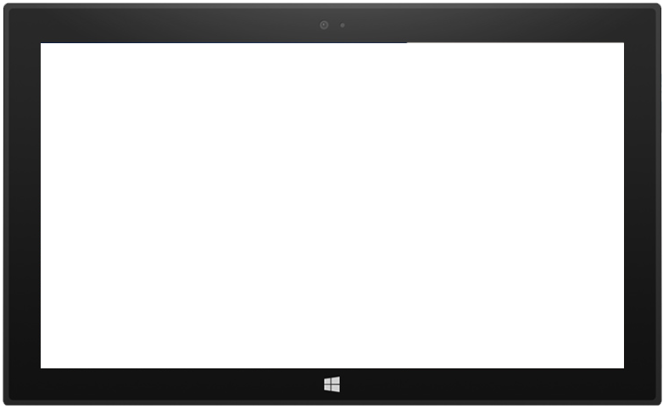
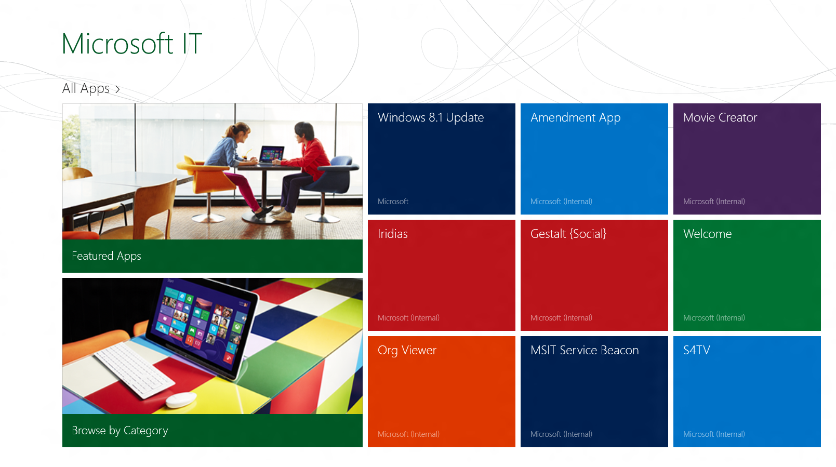
Today
Windows Store
Enterprise App Store
Modern apps
Sign in with MSA
Pay with credit card, gift card, PayPal, Alipay, INICIS, mobile operators (Phone)
MDM-driven
Sideload line-of-business modern apps
Link to apps in the Windows Store

Slide 17
One Windows Store Evolution
Windows 8.1
Windows Phone 8.1
10
Xbox
Converged developer portal for Windows and Windows Phone
Separate user and developer capabilities
Fully converged experience
Best features from each
New capabilities
Convergence

Slide 18
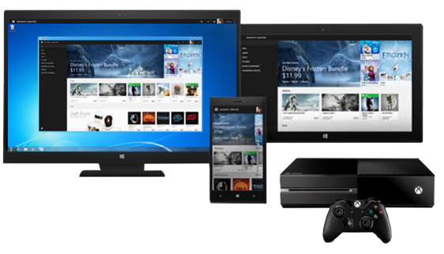
One Big Store with Everything
Curated ‘enterprise store’
Tailored app recommendations
Support for digital goods (apps, games, movies, music, etc)
Common, safe and convenient ways to pay

Slide 19
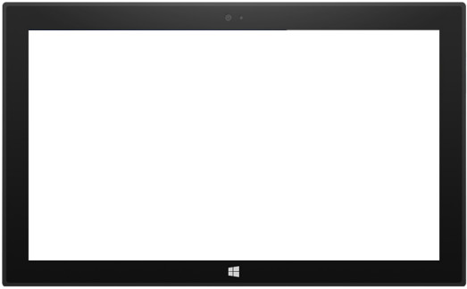
Tomorrow
Windows Store
Windows Store + BSP
“Enterprise App Store”
Modern apps
Sign in with MSA
Pay with credit card, gift card, PayPal, Alipay, INICIS, mobile operators (Phone)
Modern apps
Sign in with MSA or AAD
Pay with credit card or PO/invoice
Private Store for the org’s preferred or LOB apps
B2B purchasing and distribution
Deploy modern apps offline, in images, and more
Modern app license management
Sideload line-of-business modern apps
Deploy apps from the Windows Store (even when disabled) through BSP integration

Slide 20
Scenarios
Organization Store (Hosted)
NOTES
Cloud-based
No on-prem infrastructure requirements
No MDM service required
Apps automatically updated from the Windows Store
Can include LOB apps
IT Administrator
Sign in to Business Software Portal
Using AAD account
Apps acquired
Free apps
Purchased using a PO or invoice
ORGANIZATION STORE CREATED
Desired apps added
End User
Log into Windows
Using AD or AAD account
ACCESS WINDOWS STORE
Sees Organization Store and public categories
INSTALL APPS
Selected from the Private Store using AAD, or public categories using MSA

Slide 21
Screen Shot Walk Through: Institutional Software Portal

Slide 22
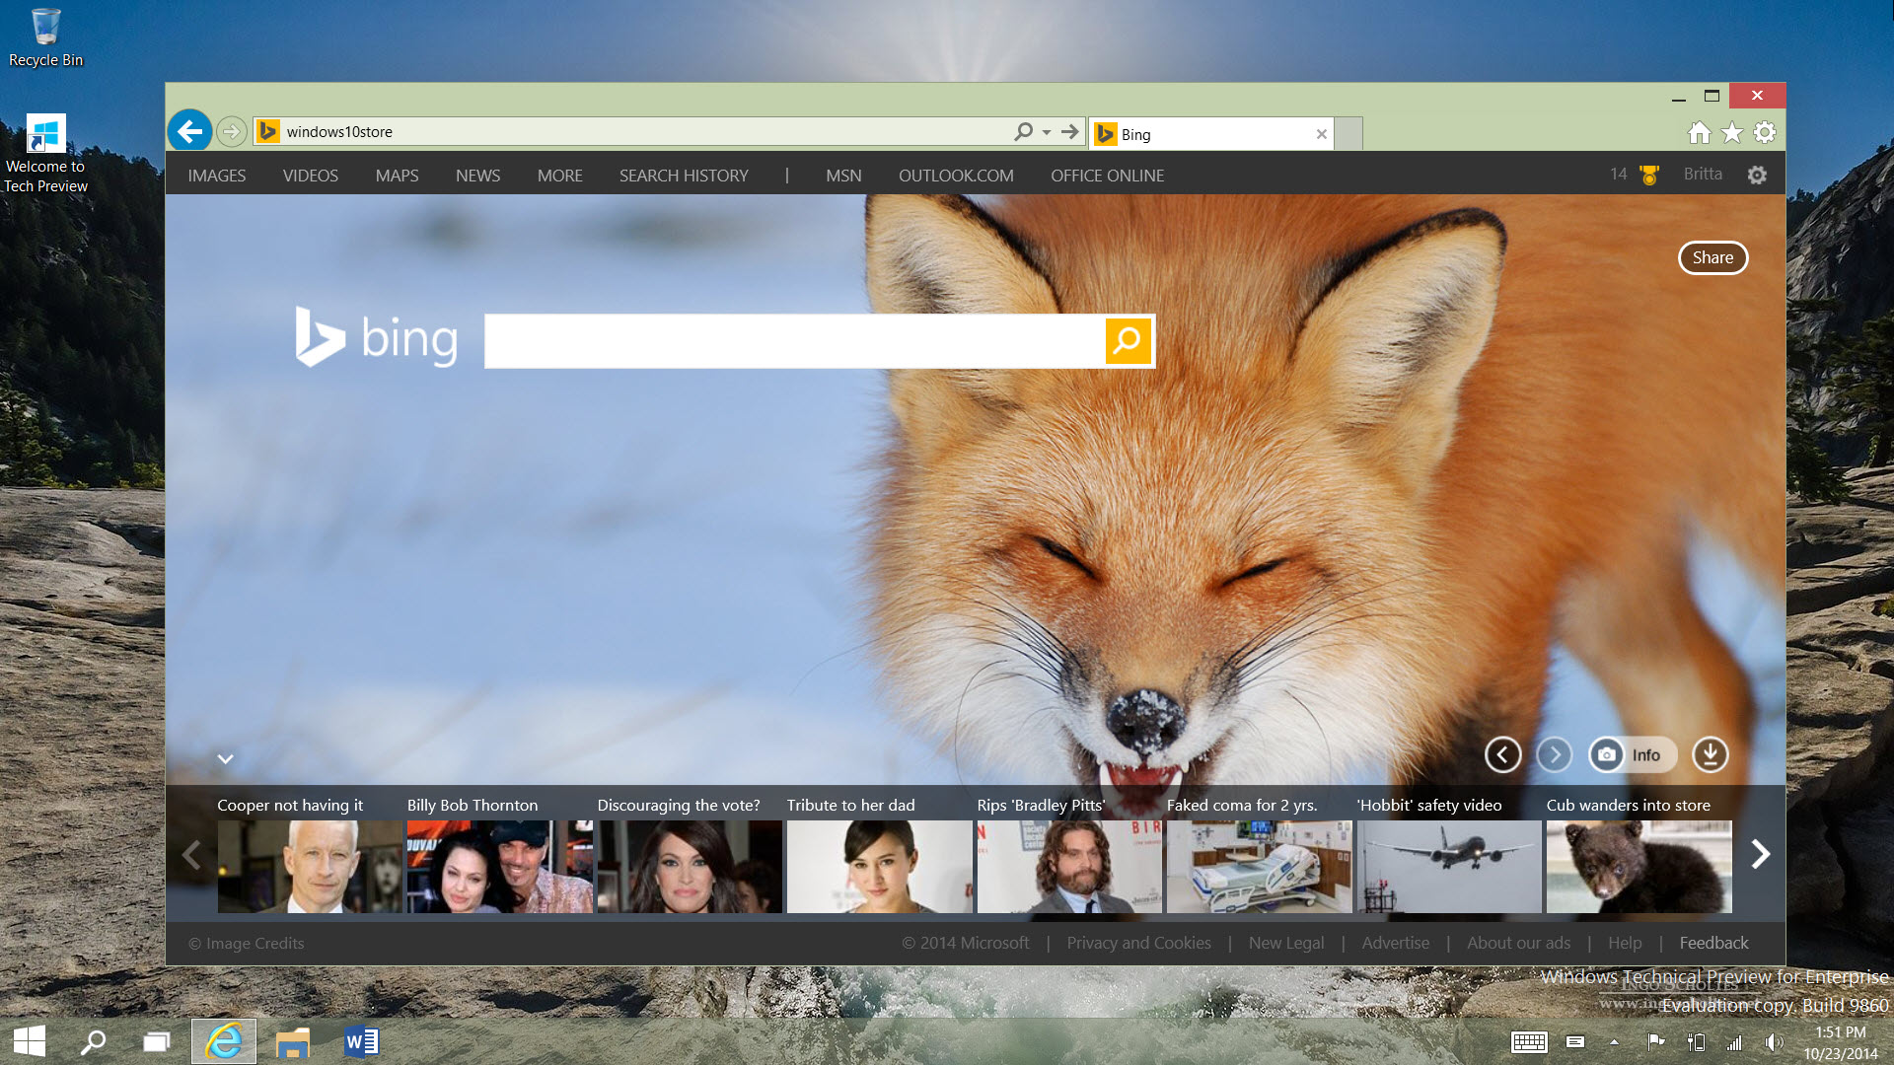

Slide 27
Scenarios
Mobile Device Management
Notes
Cloud-based or on-premises (depending on the MDM service used)
Apps automatically updated from the Windows Store
The Windows Store can be disabled if desired
IT Administrator
Sign in to Business Software Portal
Using AAD account
Apps acquired
Free apps
Purchased using a PO or invoice
Apps added to MDM service
Link to the app in the BSP
End User
Log into Windows
Using AD or AAD account
Launch Enterprise App Store (MDM)
Sees available app
Install apps
Selected from the MDM list
Installed by the Windows Store, as directed by the MDM service

Slide 28
MDM in Windows 10
MDM Enrollment
Automated provisioning
Bulk enrollment
Simple bootstrap
Un-Enrollment
Removal of enterprise data protection keys, data
Policies, Profiles, Certs, Apps
Greatly extended set of policies
Enterprise Data Protection configuration
Start screen / Start menu configuration and control
One consistent set of MDM capabilities across Mobile, Desktop, and Embedded products
New MDM capabilities also usable via SCCM
Remote Assistance & Security
Full and BYOD wipe
Reset to corporate image
Configuration and App Updates
Curated Windows Store
Volume Purchase Program app deployment
License reclaim/re-use
Certificate Renewal

Slide 29
Azure DR & Business Continuity

Slide 30
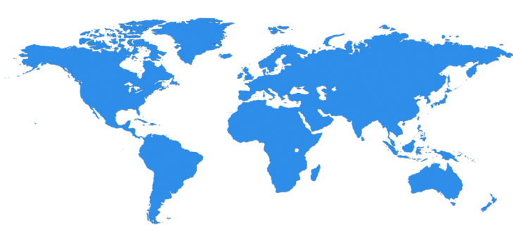
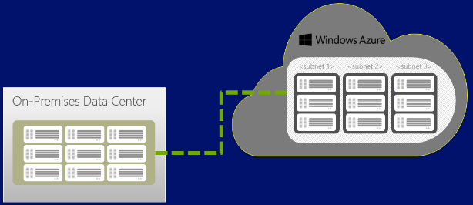
Microsoft Azure – Datacenter as a Service
Global network of Microsoft Data Centers
Raw “horsepower” for computing needs
Pay as you go / Use what you need
Affinity keeps processing near you
Locations: 35+ factors:
Proximity to Customers
Energy, Fiber Infrastructure
Skilled Workforce
Complements on-premises resources
MS maintains Azure, you maintain VMs
Azure resources 24/7 available 99.9% (fiscal)
Chicago
Dublin
Quincy
Amsterdam
Boydton
Shanghai
Japan
Cheyenne
Des Moines
Hong Kong
San Antonio
Singapore
Brazil
Australia

Slide 31
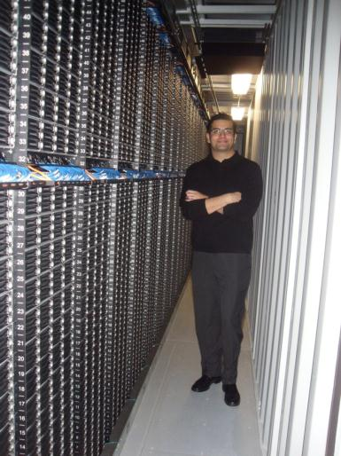
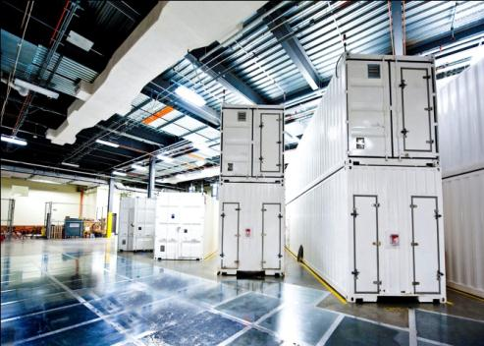
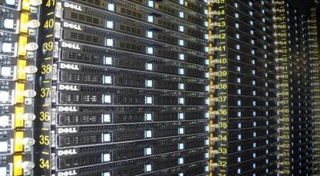
Inside an Azure Data Center – Massive Capacity

Slide 32
Today’s Demo Environment
Hybrid – Cloud on your terms
Travel Laptop: Nightly Backup 2AM Using Azure Backup
Unlimited Capacity vs. Limited Capacity
Microsoft Azure
My Home Server: Nightly Backup 1AM Using Azure Backup
AZMcBMgmt
Hyper-V in Cambridge, MA
AZMcBDC1
Virtual Rtr 137.116.48.135
Site to Site VPN
10.0.1.0/25
208.48.28.212
No more hardware purchases to demo
No increase in power consumption on-premises
Data redundancy / resiliency
AZVDIRDS
RRAS
MGMT
DC2
RDS
“Local Network”
10.2.10.2/24

Slide 33
Azure Biz Continuity Solutions
Azure IaaS – Highly-resilient Azure Fabric simplifies resiliency experience
Azure RemoteApp – “My Apps are where I am, on the Device of my choice”
OneDrive for Business – “My Data is Where I am, on the Device I own, & I have a ‘spare’ copy in the cloud”
Azure Backup – Backup your PCs / Servers directly to Azure
Azure Site Recovery (ASR) – Backup your datacenter to Azure, failover either direction / conduct tests

Slide 34
Case Study: Azure IaaS
Dowlin’s IT staff subscribed to Azure computing resources to run Microsoft Active Directory Federation Services (ADFS), which allows faculty, staff and students to use one user name and password to access the institution’s new portfolio of cloud-based applications for business automation, collaboration and customer relationship management (CRM).
Rutgers Business School Meets Its Fast-Growing IT Demands With Help From Cloud Services
When Hurricane Sandy struck the East Coast in 2012, Newark lost power for three days, forcing the school to shut down until the city recovered. “Based on that experience, we wanted to move critical components out of the data center to promote
greater availability… Azure is based on a high-availability architecture, with redundancies throughout the environment.”
- Kevin Dowlin, Executive Director, Rutgers Business School’s Office of Technology and Instructional Services
http://www.forbes.com/sites/cdw/2014/09/17/rutgers-business-school-meets-its-fast-growing-it-demands-with-help-from-cloud-services/

Slide 35
Azure – Resilient Storage Uses:
VM Disks
Serving images or documents directly to a browser
Storing files for distributed access
Streaming video and audio
Performing secure backup and disaster recovery
Storing data for analysis by an on-premises or Azure-hosted service
500TB as a standard setup, Performance Options
Microsoft Azure Storage
WEST
DC
EAST
DC
> 400 miles

Slide 36
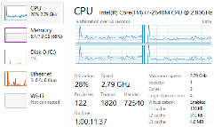
Windows Azure RemoteApp
User running RemoteApp client sees application open in a standard App window
(Memory/CPU/Disk space NOT consumed here)...
Windows Azure
3
Remote App
1
Applications execute on Azure Platform
(Memory/CPU/Disk space consumed here)...
Applications Centrally Managed on Azure
Massive scale & elasticity (VMs spawn based on demand)
Applications appear to be running locally @ the client
How to get started Blog Post
2
Individual application user interface is sent over the network connection

Slide 37
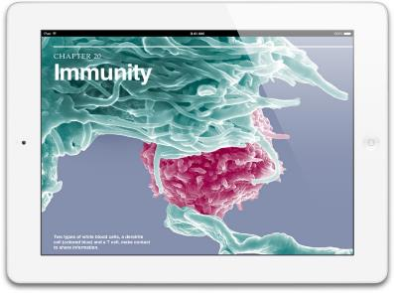
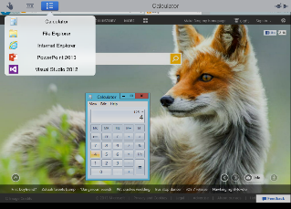
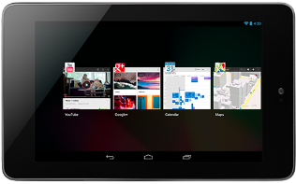
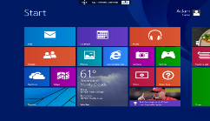
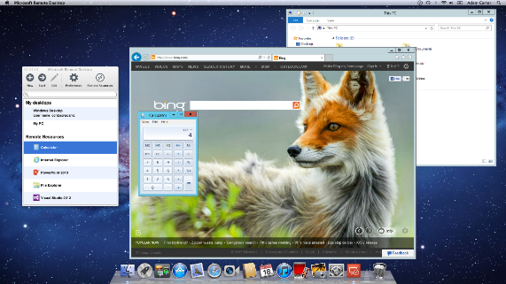
RDP from BYO devices
Provides easy access to a variety of devices and platforms including Windows, Windows RT, iOS, Mac OS X and Android. (Available in application stores in 10/2013)
Extends the rich Windows experience to BYO devices and help users be productive without compromising compliance
Provides flexibility by providing access to:
PCs (through an RD Gateway)
Personal and pooled virtual (VM)-based desktops
Session based desktops and
RemoteApp programs
Install and updates from respective Stores – no downloads from MS.com
https://itunes.apple.com/us/app/microsoft-remote-desktop/id714464092
https://play.google.com/store/apps/details?id=com.microsoft.rdc.android
https://itunes.apple.com/us/app/microsoft-remote-desktop/id715768417?mt=12

Slide 38
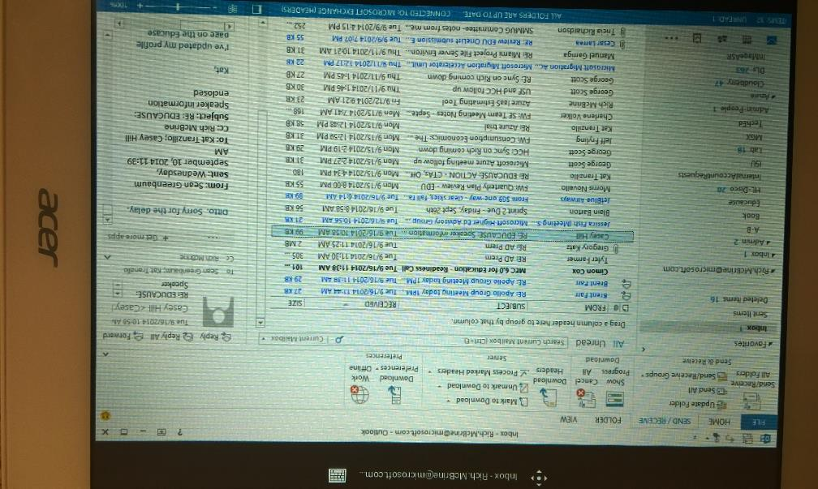
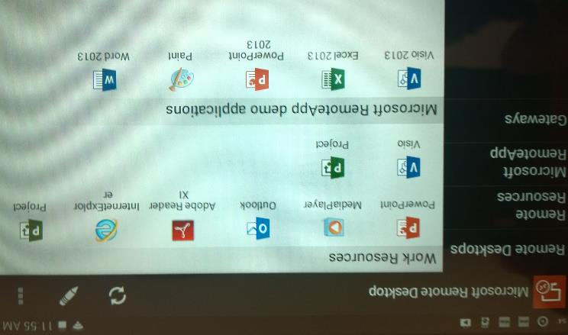
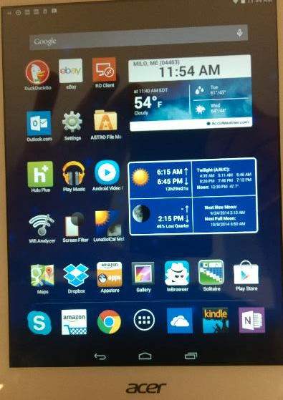
RemoteApp to Android Tablet

Slide 39
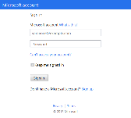
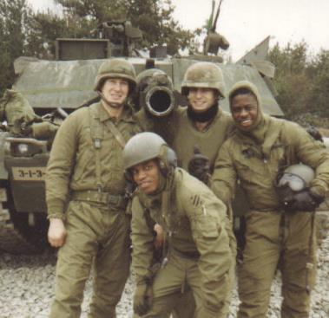
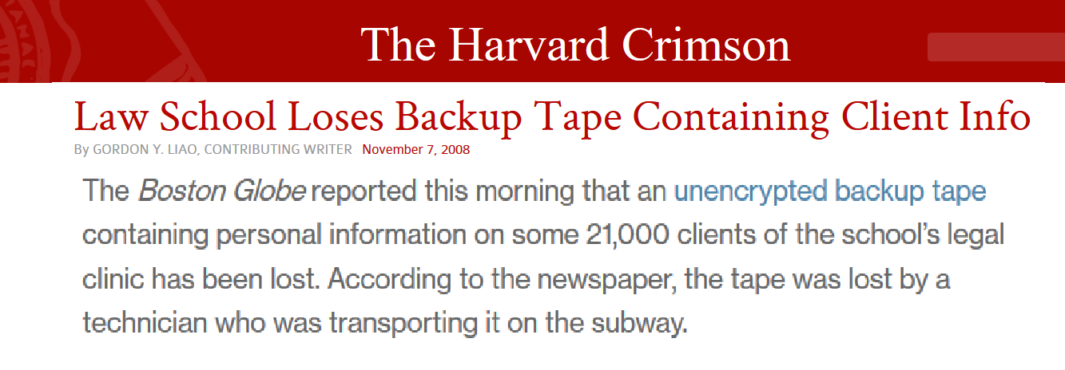
How Azure Backup Works – Azure Agent
1. Sign Up
Microsoft Azure
2. Install Agent
3. Register and Configure
4. Backup
Encrypted Data
Window Server or Windows Client
5. Recover - to the same or a different system

Slide 40
The Latest Innovation: Azure Site Recovery
Why is this latest Azure Innovation so Important?
Use Azure as a Backup Datacenter
Replicate on-premises Hyper-V guests to Azure (VMWare version is coming soon!)
“Cold” duplicates kept in Azure
Failover supports Planned, Unplanned, Test (in Azure)
Triggers & startup precedence built in
Long-term possibility to replace backup datacenter – reduce costs and simplify management
Azure can handle on-demand capacity requirements & manage failover process
Leverages investments in on-premises hardware yet simplifies IT workload to test, backup, failover, and recover data
VM OS agnostic
1. Create ASR Vault
Microsoft Azure
Unpredictable Demand
2. Install VMM Agent
3. Register and Configure
Resources
4. Replicate Selected VMs
VMM or Standalone Hyper-V
5. Failover to Azure / Back to On-Prem/ Test
No site-to-site VPN/ExpressRoute Required

Slide 41
What’s Coming: VMWare/Physical version of ASR
Agent installed per VM/Physical Box
On-premises & cloud VMs to centralize management and heavy lifting
Based on acquired technology (InMage)
First-class citizen in ASR - same feature set, different tech in play
1. Create ASR Vault
ASR Management VMs
Microsoft Azure
2. Install Agents
3. Register and Configure
Combo of VMWare VMs and Physical Systems
4. Replicate Selected VMs
ASR Management VMs
5. Failover to Azure / Back to On-Prem/ Test
No site-to-site VPN/ExpressRoute Required

Slide 42
Q&A
© 2014 Microsoft Corporation. All rights reserved. Microsoft, Windows, and other product names are or may be registered trademarks and/or trademarks in the U.S. and/or other countries.
The information herein is for informational purposes only and represents the current view of Microsoft Corporation as of the date of this presentation. Because Microsoft must respond to changing market conditions, it should not be interpreted to be a commitment on the part of Microsoft, and Microsoft cannot guarantee the accuracy of any information provided after the date of this presentation. MICROSOFT MAKES NO WARRANTIES, EXPRESS, IMPLIED OR STATUTORY, AS TO THE INFORMATION IN THIS PRESENTATION.

